Slide 1
NoSQL
By Memona Haq

Slide 2
Outline
"Not Only SQL" or "Not SQL“
Doesn’t have restrictions and challenges of traditional databases
Traditional RDBMS use SQL syntax and queries to analyze data
Notes:
-a new type of databases which has evolved due to the restrictions and challenges with the traditional databases.
-Traditional RDBMS uses SQL syntax and queries to analyze data

Slide 3
Challenges of traditional RDBMS
Not optimized for horizontal scaling out
Data has increased tremendously to the range of petabytes
Schema-less data
Majority of the data comes in a semi-structured or unstructured format
Cost
High licensing cost for data analysis
High Velocity of data ingestion
RDBMS lacks in high velocity because it’s designed for steady data retention rather than rapid growth
Notes:
So, what were the challenges is traditional RDBMS that leads to the evolution of NoSQL?
Traditional databases are not optimized for horizontal scaling out
If we can have a cluster of MySQL database we can create shards but this is not what they are designed for
For a huge dataset growing beyond hundreds of terabytes we need a NoSQL database
Schema-less data
Secondly for the new type of data we need some system which can have less constraint over the type of the data as RDBMS don’t support this
Firstly we must declare the schema and then there are lots of constraints which can be imposed on the data
High Velocity of data ingestion
As RDBMS can be very expensive for large datasets it is not suitable when data keeps coming at a higher rate or for high velocity data
All these together led to the evolution of NoSQL database.

Slide 4
Features of NoSQL Databases
Generic Data Model
Heterogeneous containers, including sets, maps and arrays
Dynamic type discovery and conversion
NoSQL analytics system support runtime type identification and conversion so that custom business logic can be used to dictate analytic treatment of variation
Non-Related and De-normalized
Data is stored in a single table as compared to storing it in joining multiple tables
Notes:
NoSQL databases use a Generic Data Model
There are heterogeneous containers, including diverse datatypes like sets, maps and arrays
And they perform Dynamic type discovery
We don't need to specify the data type all the time, this is something the database will interpret depending on the type of data that is getting loaded
And they perform Dynamic type discovery and conversion
The conversion between the data using noSQL is implicit
Non-Related and De-normalized
The NoSQL database store the data usually in a single table as they have less inclination towards joinging of the data
The data is stored in raw format or denormalised format which can be very useful

Slide 5
Features of NoSQL Databases Cont.
Highly Distributable
Distributed databases can store and process a set of information on more than one device
Commodity Hardware
Adding more of the economical servers allows NoSQL databases to scale to handle more data
Notes:
Highly Distributable
NoSQL databases can be built in a cluster of commodity hardware as they are highly distributable.
Commodity Hardware
NoSQL databases are base on the core principle of supporting horizontal scaling out

Slide 6
NoSQL Database Types
Document Databases
Pair each key with a complex data structure known as a document
Documents can contain many different key-value pairs or key-array pairs or even nested documents
Consumes more space as compared to counterparts
MongoDB is an example of this type
Collections contain lots of documents
Each document contains diverse and heterogeneous fields
Notes:
Having learned about the features, let’s now explore the NoSQL data types:
Document Databases
It is a database where every entry, every message, every row of the RDBMS is like one document containing key value pairs
They can have nested documents, or the embedded documents
MongoDB is an example of one such database
And an example of such element is record or the word document
Each document contains diverse and heterogeneous fields
A collection is like a table, for the same collection different documents can have different key value pairs that makes it quite heterogeneous and dynamic in the schema

Slide 7
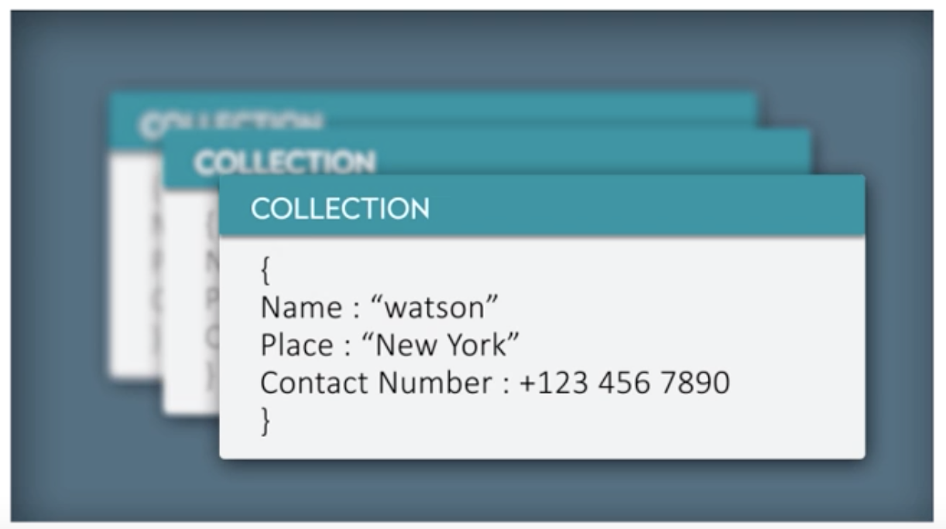
NoSQL Database Types Cont.

Slide 8
NoSQL Database Types Cont.
Graph Stores
Used to store information about networks of data, such as social networking connections
Graph stores include Neo4J
Not very well suited for all sets of problems
Best suited for connected data
Notes:
Graph Stores
Sometimes there are lots of dependencies on data this can be a social network data like something on Twitter
or it may be the purchase pattern or purchase sale relationship
If there are a lot of relationship between different types of data the in that situation the traditional RDBMS uses a lot of join operations which is quite expensive
For such use cases we have graph databases
Neo4j is one of them
The disadvantage of such database is that it might not be suited for different sets of problems
However the advantage lies in the fact that if there is a lot of interconnections between the data then this is highly suited
A significant example is the social media data

Slide 9
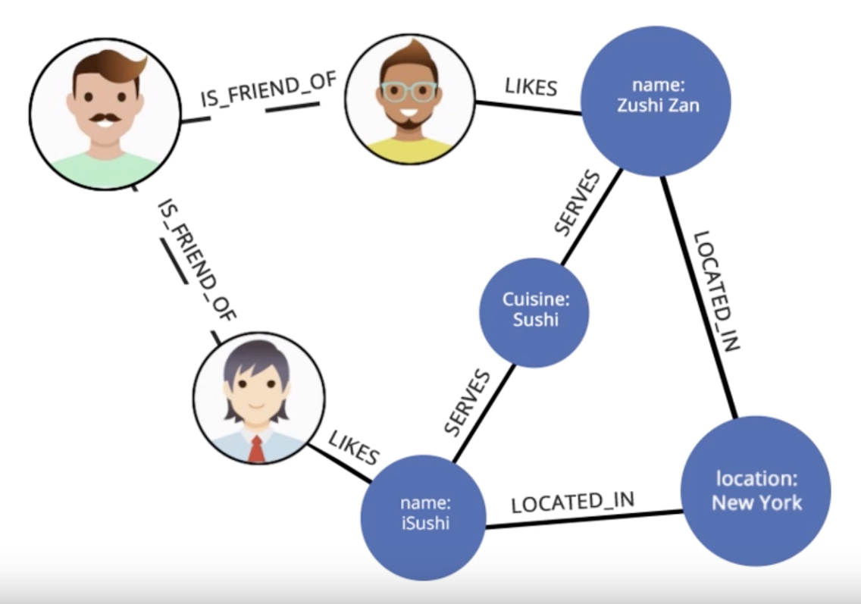
NoSQL Database Types Cont.
Notes:
Suppose there is a person who can be a friend of someone and if the person likes something then he can post something also
His post can get a lot of comments which can be termed as relationships between the different entities forming a graph
In this graph every node is an actor and every edge is like a verb
There is a relationship between edges and nodes (entities or actors)

Slide 10
NoSQL Database Types Cont.
Wide-Column Stores
Store columns of data together, instead of rows
Cassandra and HBase are optimized for queries of large datasets
Excellent for lookup on a single field
Lookup on other fields not supported
Notes:
Wide-Column Stores
In these type of databases we combine or group multiple columns together to create a column family
There are multiple advantages of using this, one of which is if you want to data only from a single column family then the other column family are not scanned
Cassandra and HBase are are very good examples for this particular data set
They are excellent for lookup and range to scan a particular range of columns

Slide 11
NoSQL Database Types Cont.

Slide 12
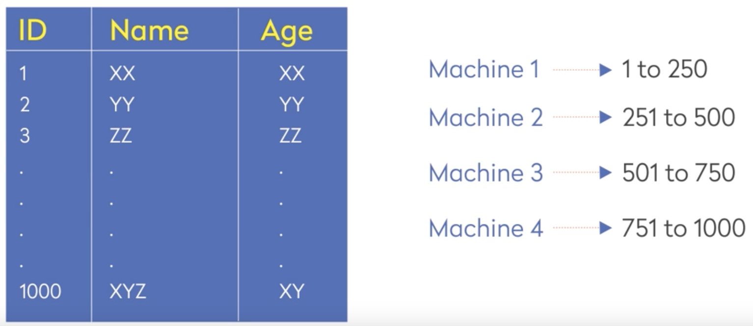
CAP Theorem
NoSQL databases are meant for distributed storage
Notes:
An important theorem in NoSQL databases. NoSQL databases are meant for distributed storage. This can be explained by something like, suppose you have a particular table which contains id and age.
There are ids present starting from one and two till one thousand. It makes sense to have it in one machine where you can store ids from 1 to 250. The id’s 251 to 500 you can store in another machine and so on. Ultimately, we require 4 machines with the final machine having the ids from 751 to 1000. This means you distribute the data by storing them across different machines. This is how the distribution works and assume that this is the design you are following.

Slide 13


Slide 14
CAP Theorem Cont.
Consistency
The data in the database remains consistent after the execution of an operation. For example after an update operation, all clients see the same data
Availability
The system is always on (service guarantee availability), no downtime
Partition Tolerance
The system continues to function even if the communication among the servers is unreliable, i.e. the servers may be partitioned into multiple group that cannot communicate with one another
Notes:
Let’s get ahead with the challenges that we will come across in this case.
Consistency means the data in the database must be consistent before and after the execution. Suppose there are multiple users, in such case, every user should see the same data.
Availability of the system should be always up and running even in case if a few machines go down. It should be able to operate the working machines.
And finally, it should be partitioned tolerant even if the own machine goes down. This machine going down should not hamper the working of the other machines.

Slide 15

CAP Theorem Cont.
Notes:
Let go back to where we have divided our data across the 4 machines, suppose machine 1 goes down and you wont be able to access the ID from 1 to 250
But the other ids can be accessed. In such a case you can increase the availability by replicating the data.

Slide 16
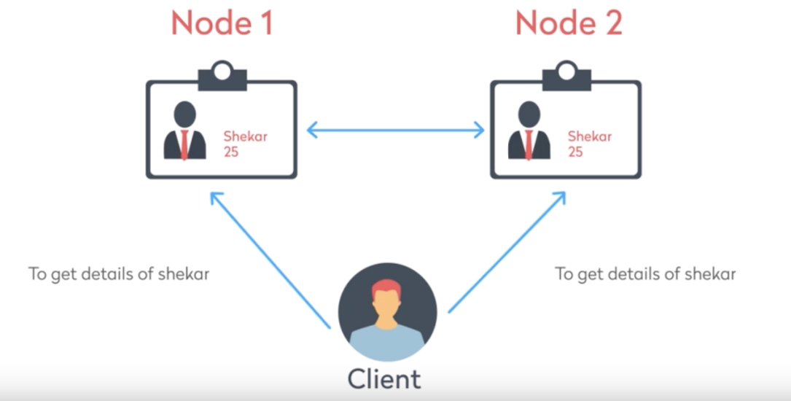
CAP Theorem Cont.
Copy of the same data is maintained on multiple machines
This increase availability, but decreases consistency
Notes:
By storing the same data on 2 machines this will make it more available
People can query the first node or second node to fetch the data even if the master machine goes down we can always get the data from another machine

Slide 17
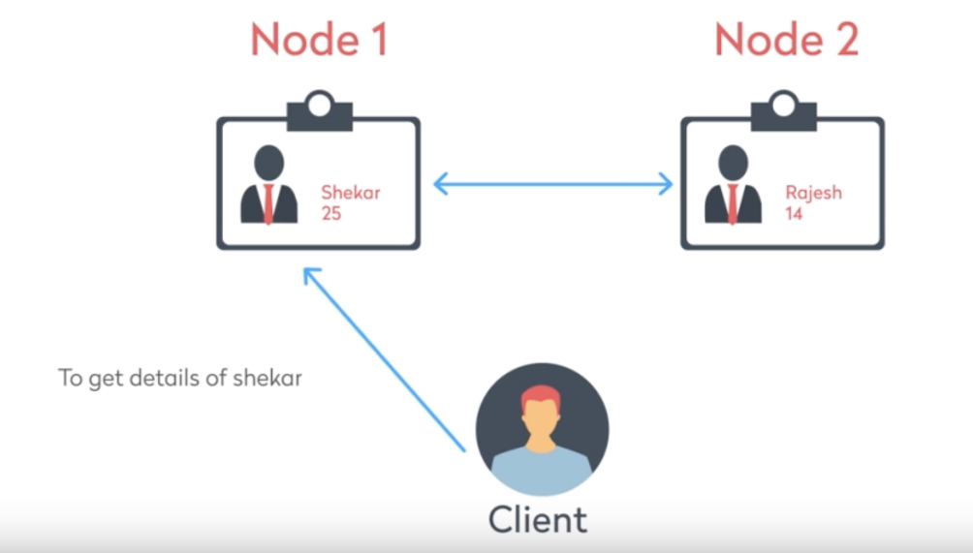
CAP Theorem Cont.
If copy of the same data is not maintained, consistency is higher
But availability decreases
Notes:
But think of a situation where if you don’t maintain the duplicate data and if one record is present in only one machine you might have less availability but the consistency will be higher

Slide 18
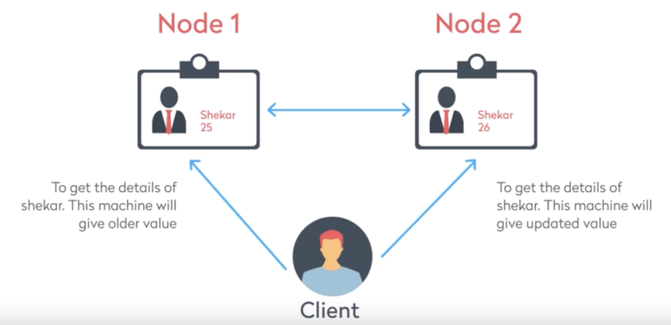
CAP Theorem Cont.
If data on one machine changes, the update propagates to the other
System is temporarily inconsistent, but will eventually become consistent
Notes:
In the previous example if data was at the second machince and if you had to update the data at one place the same would not be immediately reflected to the other machine
Unless the updates are reflected the design will be consistency as he user will get a different value for the same data on querying for it in different machines
So we see that this design had higher availability but less consistency

Slide 19
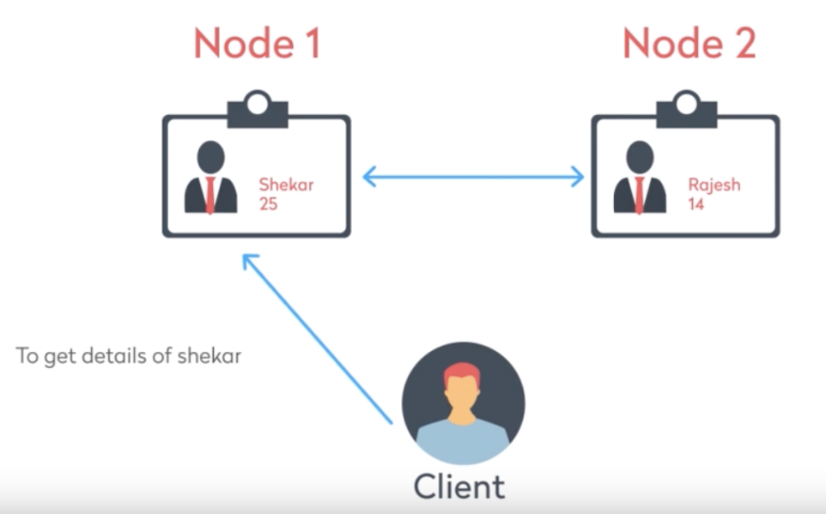
CAP Theorem Cont.
If a copy of the same data is not maintained, consistency is higher
But availability decreases
Notes:
but if you don’t replicate the data this less availability but higher consistency
As if you make an update in one place and every user will have the same data

Slide 20
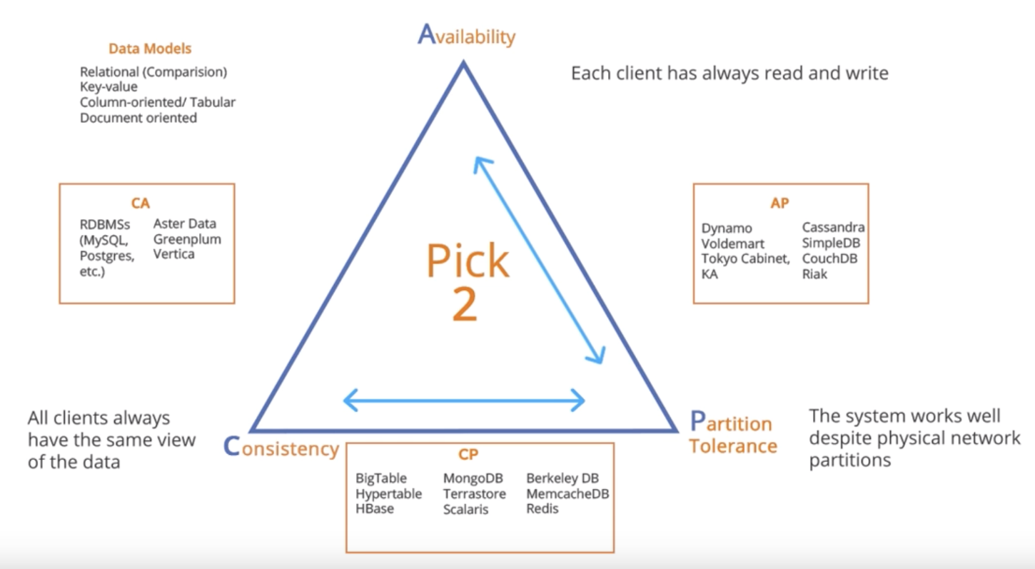
CAP Theorem Cont.
Notes:
According to the cap theorem, out of C, A and P, you can only have 2 for the distributed database
Partition tolerance is quite important as even if one machine goes down you should be able to read from the other machines
If you want availability by replication then consistency will be compromised
If you want a higher consistency by not replicating your data then your availability will be compromised
You can only choose 2 out of C A and P, as partition tolerance is mandatory for distributed databases
You have to choose between C and A for the other

Slide 21
Exercise
Let us assume that we have 1000 applications which access a NoSQL database for lookup. The lookup table is a static one and the content gets refreshed less frequently. If the application can tolerate working with stale data as well, which category of NoSQL database should one opt for?
CA
AP
CP
Either CA or AP, but not CP
Notes:
AP
Consistency is less important, not a lot of change, and stale data is fineish
A more important as we have a lot of users accessing this data

Slide 22
MongoDB
Open-source, cross-platform document-oriented database
Uses JSON like documents to store data
Commonly used as a database component in MEAN stack
Notes:
JavaScript Object Notation is an open-standard file format that uses human-readable text to transmit data objects consisting of attribute–value pairs and array data types
Advantages of MongoDB over RDBMS
Schema less − MongoDB is a document database in which one collection holds different documents. Number of fields, content and size of the document can differ from one document to another.
Structure of a single object is clear.
No complex joins.
Deep query-ability. MongoDB supports dynamic queries on documents using a document-based query language that's nearly as powerful as SQL.
Tuning.
Ease of scale-out − MongoDB is easy to scale.
Conversion/mapping of application objects to database objects not needed.
Uses internal memory for storing the (windowed) working set, enabling faster access of data.
Why Use MongoDB?
Document Oriented Storage − Data is stored in the form of JSON style documents.
Index on any attribute
Replication and high availability
Auto-sharding
Rich queries
Fast in-place updates
Professional support by MongoDB
Where to Use MongoDB?
Big Data
Content Management and Delivery
Mobile and Social Infrastructure
User Data Management
Data Hub

Slide 23
MongoDB Terminology
Database – a physical container that holds a set of collections
Collection – a set of documents (tables)
Document – the basic unit of storing data. A set of key-value pairs (row)
Field – makes up a document (columns)
Field and its associated value are stored in a key-value pair
_id – represents a unique document (primary key)
Notes:
Documents also referred to as objects
Represented like JSON
Data stored and queried in BSON
Binary representation of JSON like data

Slide 24
Document Example

Slide 25
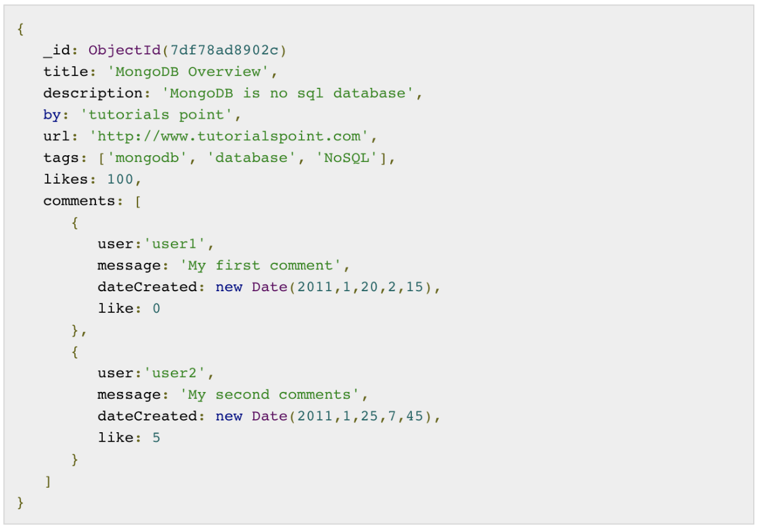
Document Example
Notes:
_id is a 12 bytes hexadecimal number which assures the uniqueness of every document. You can provide _id while inserting the document. If you don’t provide then MongoDB provides a unique id for every document.

Slide 26
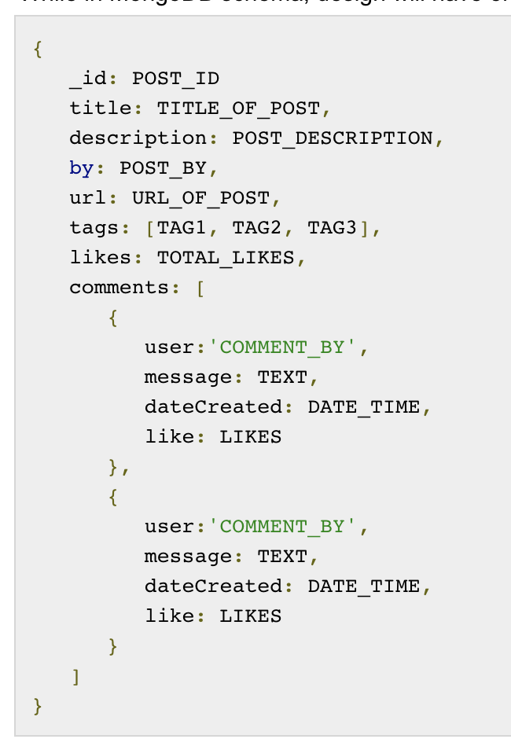
MySQL vs. MongoDB
Notes:
Suppose a client needs a database design for his blog/website
So while showing the data, in RDBMS you need to join three tables and in MongoDB, data will be shown from one collection only.

Slide 27
Creating and Deleting
Create Database
use DATABASE_NAME
Delete Database
db.dropDatabase()
Create Collection
db.createCollection(name, options)
Delete Collection
db.COLLECTION_NAME.drop()
Notes:
MongoDB use DATABASE_NAME is used to create database. The command will create a new database if it doesn't exist, otherwise it will return the existing database.
In MongoDB default database is test. If you didn't create any database, then collections will be stored in test database.
This will delete the selected database. If you have not selected any database, then it will delete default 'test' database.
In the command, name is name of collection to be created. Options is a document and is used to specify configuration of collection.
Options parameter is optional, so you need to specify only the name of the collection. Following is the list of options you can use −

Slide 28
CRUD Operations
Create
Read
Update
Delete

Slide 29
Create Operations
db.collection.insertOne()
db.collection.insertMany()
Notes:
Create or insert operations add new documents to a collection. If the collection does not currently exist, insert operations will create the collection.
In MongoDB, insert operations target a single collection. All write operations in MongoDB are atomic on the level of a single document.

Slide 30
Read Operations
db.collection.find()
Notes:
Read operations retrieves documents from a collection; i.e. queries a collection for documents.
You can specify query filters or criteria that identify the documents to return.

Slide 31
Update Operation
db.collection.updateOne()
db.collection.updateMany()
db.collection.replaceOne()
Notes:
Update operations modify existing documents in a collection
In MongoDB, update operations target a single collection. All write operations in MongoDB are atomic on the level of a single document.
You can specify criteria, or filters, that identify the documents to update. These filters use the same syntax as read operations.

Slide 32
Delete Operations
db.collection.deleteOne()
db.collection.deleteMany()
Notes:
Delete operations remove documents from a collection
In MongoDB, delete operations target a single collection. All write operations in MongoDB are atomic on the level of a single document.
You can specify criteria, or filters, that identify the documents to remove. These filters use the same syntax as read operations.

Slide 33
Demo: MongoDB
https://docs.mongodb.com/manual/tutorial/install-mongodb-on-windows/
Notes:
use mymongodb
db
db.dropDatabase()
show collections
db.uses.insertOne({name: “mimi”, age:26})
db.users.find()
db.users.update({name: “mimi”}, {$set: {age:25}})
db.users.deleteOne({name: “mimi2”})

Slide 34
Exercise
Create a myblogs database
Create a articles collection
Insert a document into the articles collection with the following fields
title, description, author, url, tags, likes

Slide 35
Solution
db.articles.insert({
title: ‘Why cats meow?’,
description: ‘An in dept discussion of cats and meowing’,
author: ‘mimi’,
url: 'http://myblog.com’,
tags: [‘cats', ‘meow', ‘meaning of life’],
likes: 100
})

